Slide 1
BA with R- S23
TELCO CUSTOMER
CHURN PREDICTION

Slide 2
Topics of Discussion
01 Introduction
02 Objectives
03 Dataset
04 Visualizations
05 Prediction Models
06 Results and Analysis
P a g e 2

Slide 3
Introduction
What is customer churn?
Customer churn, also known as customer attrition or defection, refers to the rate at which customers are lost. In the telecommunications industry, customer churn is a crucial business metric that is used to predict the number of customers likely to leave a service provider. Churn is significant because it directly affects a service provider's competitiveness, as it represents the proportion of clients leaving the provider. To maintain profitability, the provider must find new clients, which can be costly and challenging.
Reducing customer churn is essential because acquiring new customers is more expensive than retaining existing ones. Therefore, TELCO companies can implement targeted strategies to decrease customer churn by identifying the most influential factors leading to churn.
ABC
P a g e 3

Slide 4
Objectives
What is the main goal?
The main business objective of the TELCO customer churn prediction model is to help companies reduce customer churn and retain their customers.
The project will analyze relevant customer data, including customer account information, services signed up for, and demographic information. The insights generated from the analysis will be used to develop focused customer retention programs, including personalized offers, improved customer service, and targeted marketing campaigns to keep customers engaged and satisfied. Ultimately, the project aims to reduce customer churn and increase customer loyalty, which can positively impact the company.
The problem involves developing an accurate predictive model, which can identify customers at risk of leaving based on various factors such as demographics, usage patterns, and customer service interactions. This can be achieved through machine learning techniques in R, including logistic regression, decision trees, and random forests.
P a g e 4

Slide 5
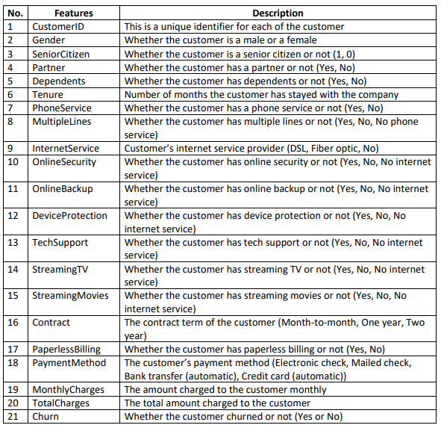
Data
set
Telco Customer Churn
The data has been sourced from Kaggle
(https://www.kaggle.com/datasets/blastchar/telcocustomer-churn), where each row represents a unique customer, and each column comprises the customer's attributes as described in the corresponding metadata. The dataset consists of 7043 rows and 21 columns, encompassing various features.
The dataset provides details on:
• Customers who have terminated services within the last month
•The various services customers have subscribed to predict how it affects the churning process
•Demographic information about the customers
The insights generated from this analysis will be used to develop focused customer retention programs, including personalized offers, improved customer service, and targeted marketing campaigns to keep customers engaged and satisfied.
P a g e 5

Slide 6
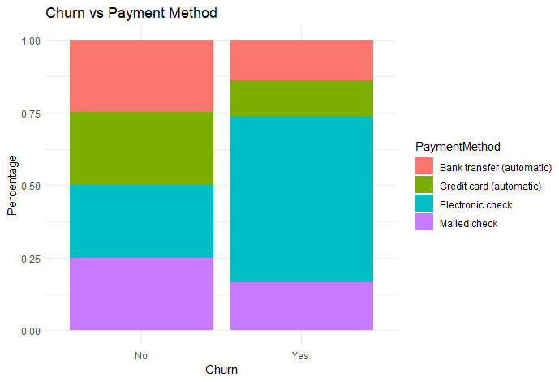
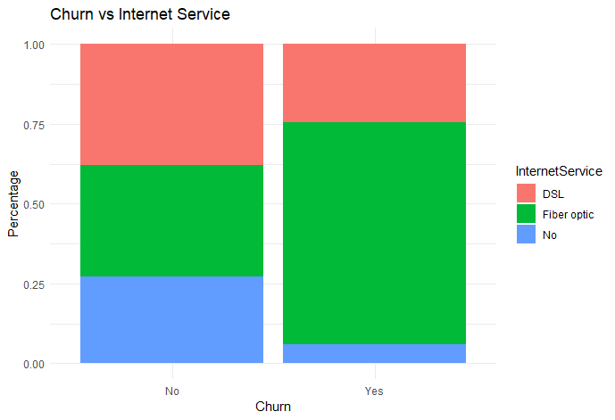
Visualizations
Relation between churn and attributes
P a g e 6

Slide 7
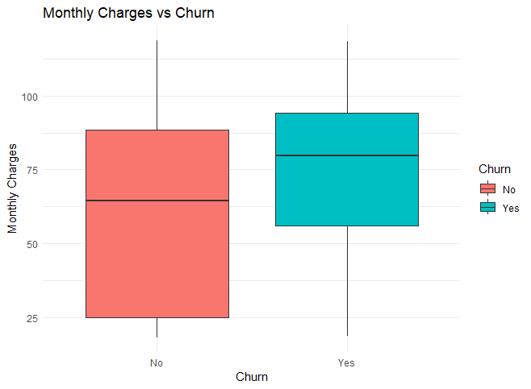
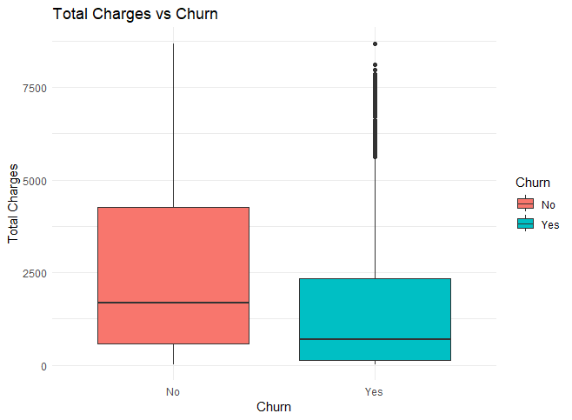
Visualizations
Relation between churn and attributes
P a g e 6

Slide 8
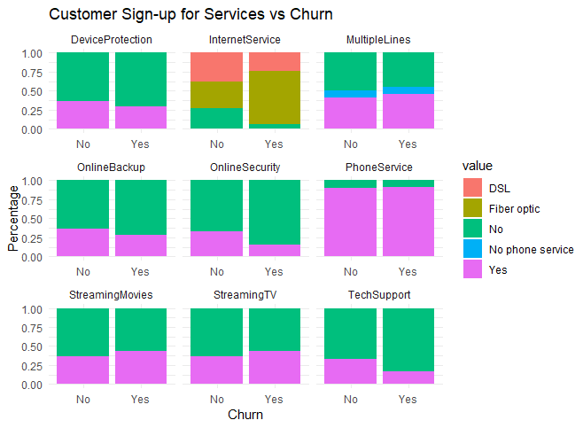
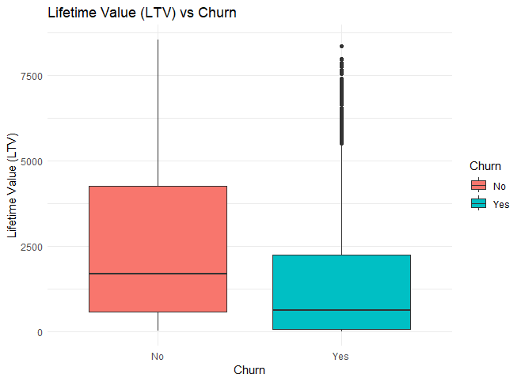
Visualizations
Relation between churn and attributes
P a g e 7

Slide 9
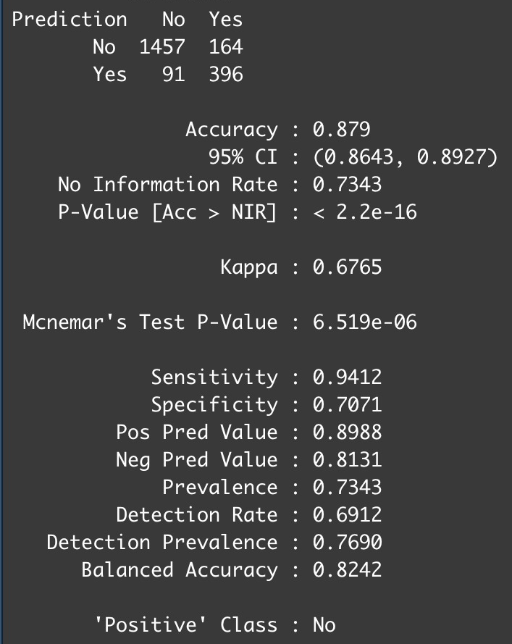
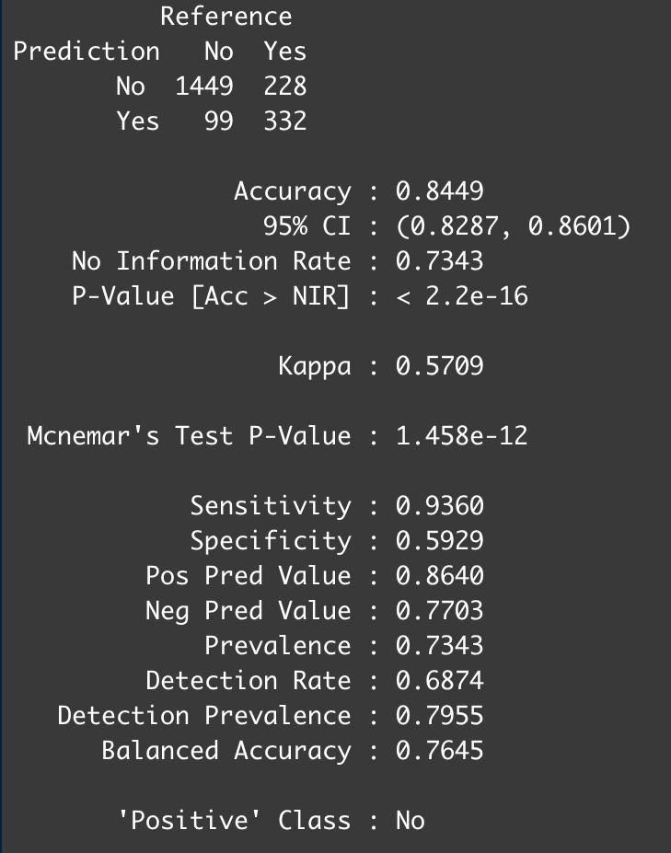
Prediction Models
LINEAR REGRESSION
RANDOM FOREST
P a g e 8

Slide 10
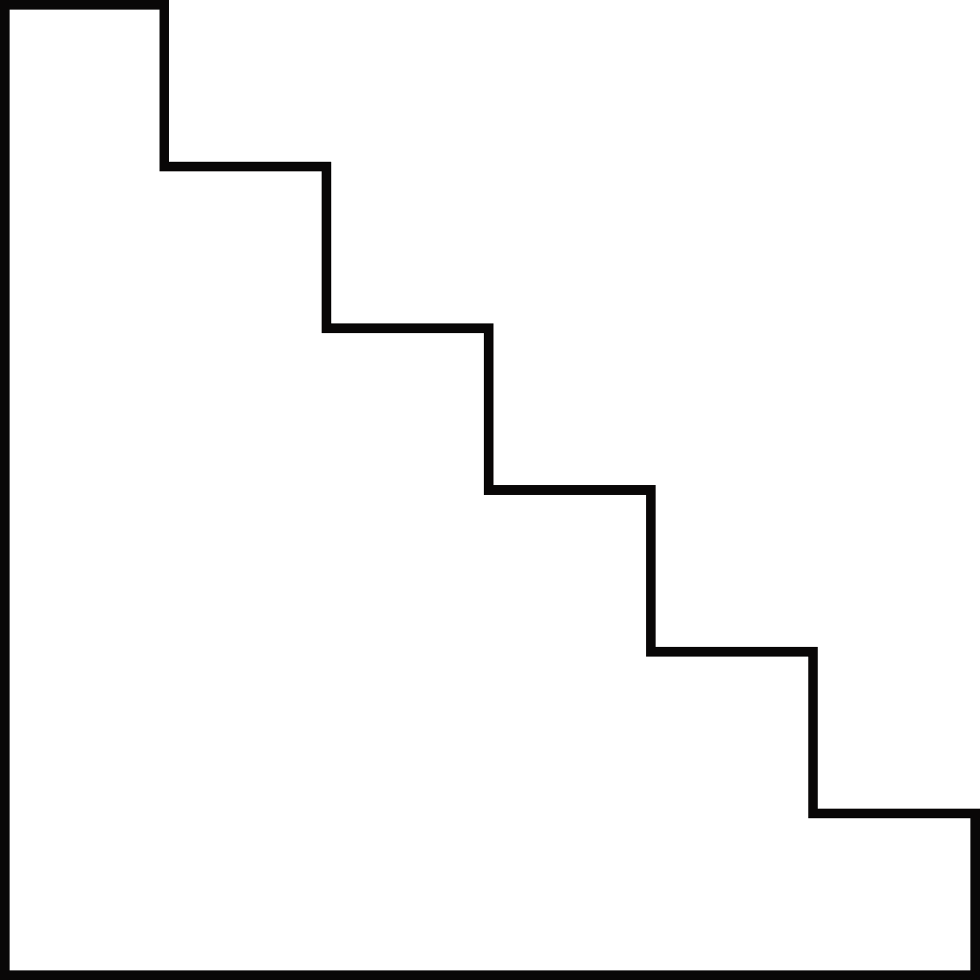
Results and Analysis
What was the conclusion?
GLM outperforms RF in terms of accuracy.
Furthermore, based on the model's output, targeted marketing campaigns should be implemented to retain customers and potentially improve the retention of 396 customers.
The analysis suggests that customers who have been with the company for a longer duration are less likely to churn.
Additionally, customers who churned have a shorter tenure than those who did not churn.
Most customers in the dataset are younger individuals, and those who use the internet service add-ons have a lower churn rate compared to those who do not.
Lastly, customers with a monthly plan have the highest churn rate.
The analysis reveals that several factors, such as tenure group, contract type, paperless billing, monthly charges, and internet service, play a role in customer churn. Gender does not appear to be related to the churn rate.
Customers with a month-to-month contract, paperless billing, and a tenure of fewer than 12 months are more likely to churn.
Conversely, customers with one- or two-year contracts, a tenure of more than 12 months, and who do not use paperless billing are less likely to churn.
P a g e 9

Slide 11
Thank You!
P a g e 10

