Slide 1
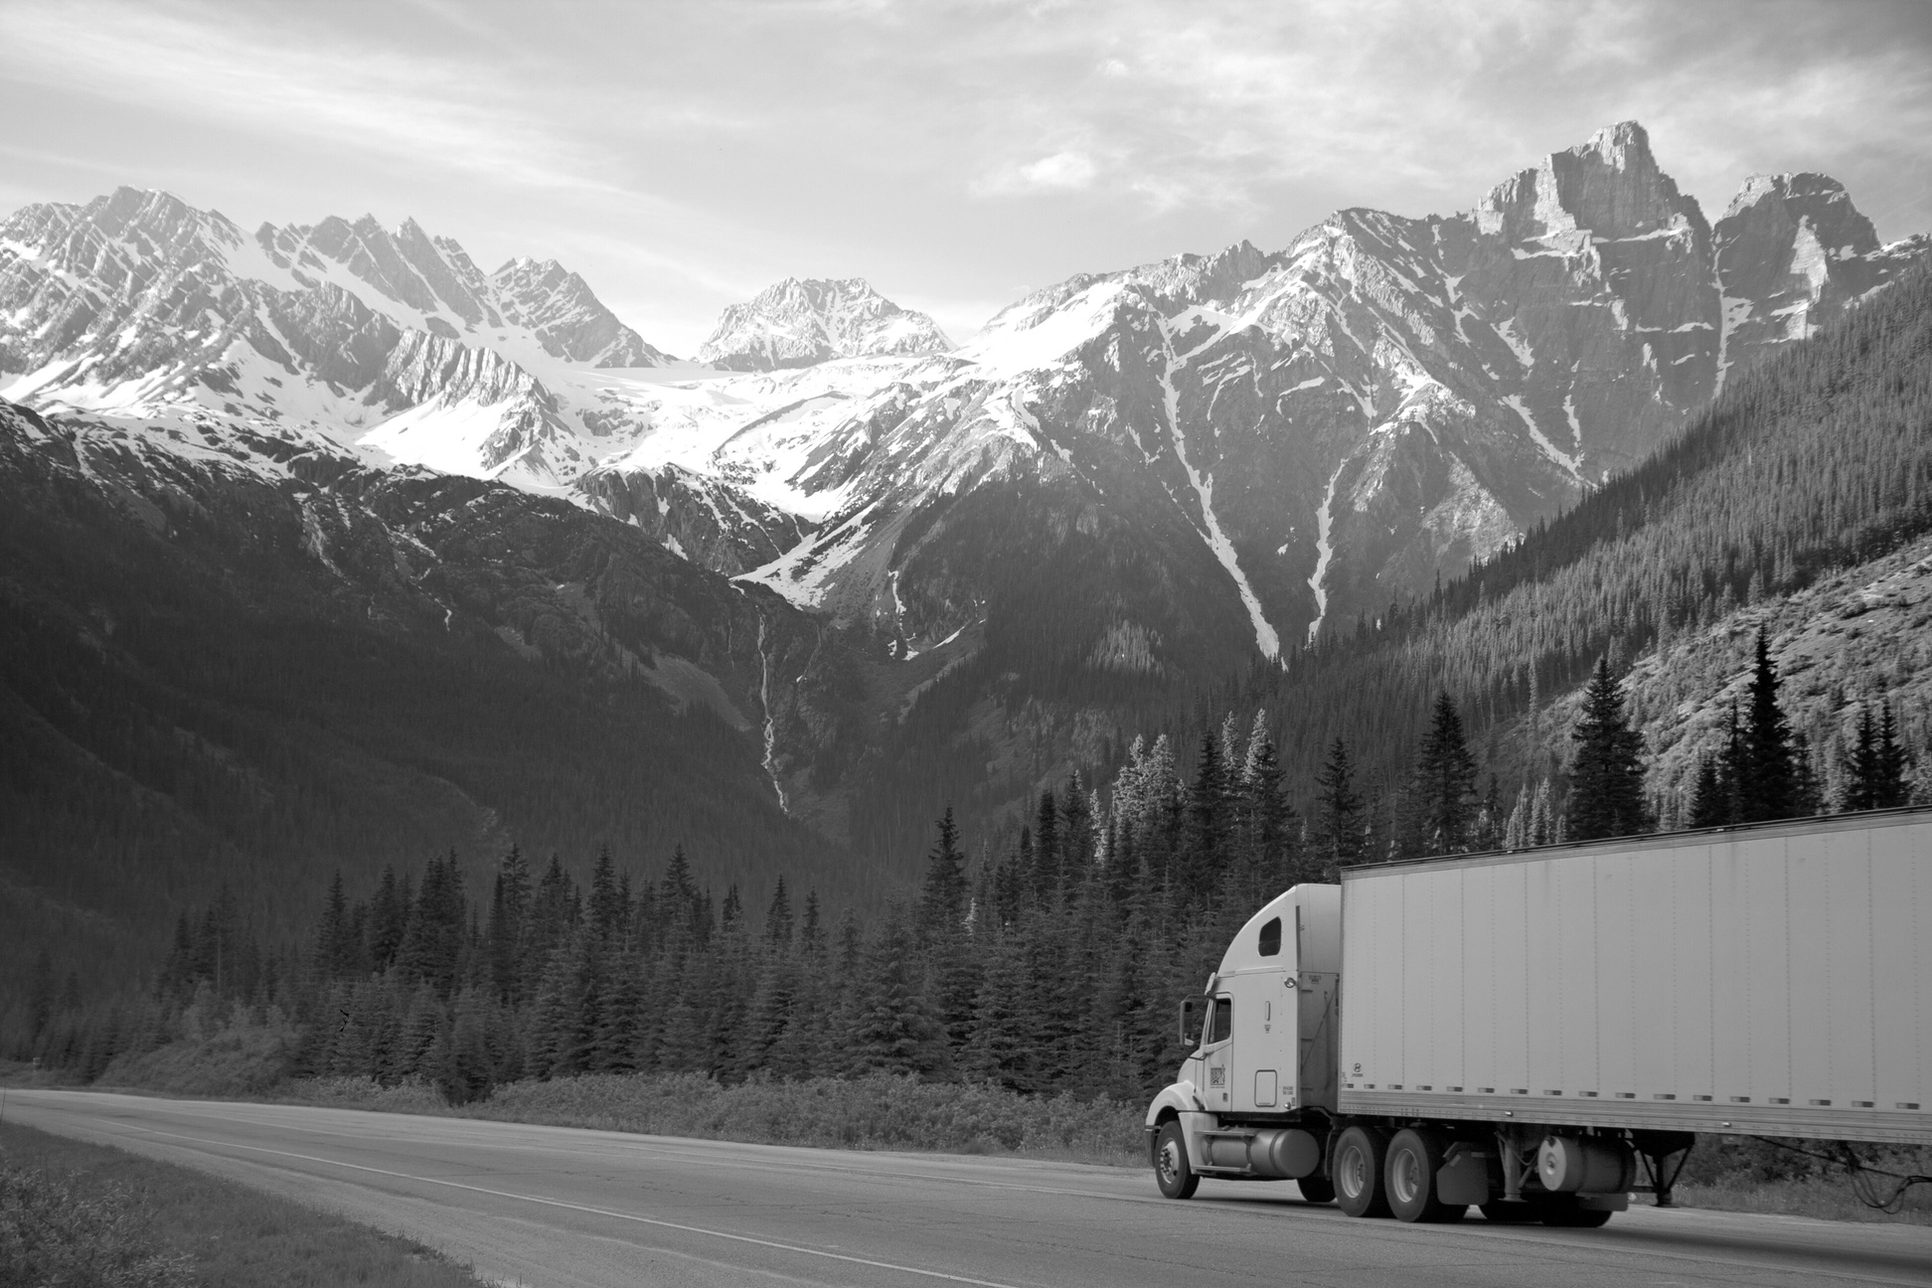

01
Risk Analysis
of Truck Drivers​

Slide 2

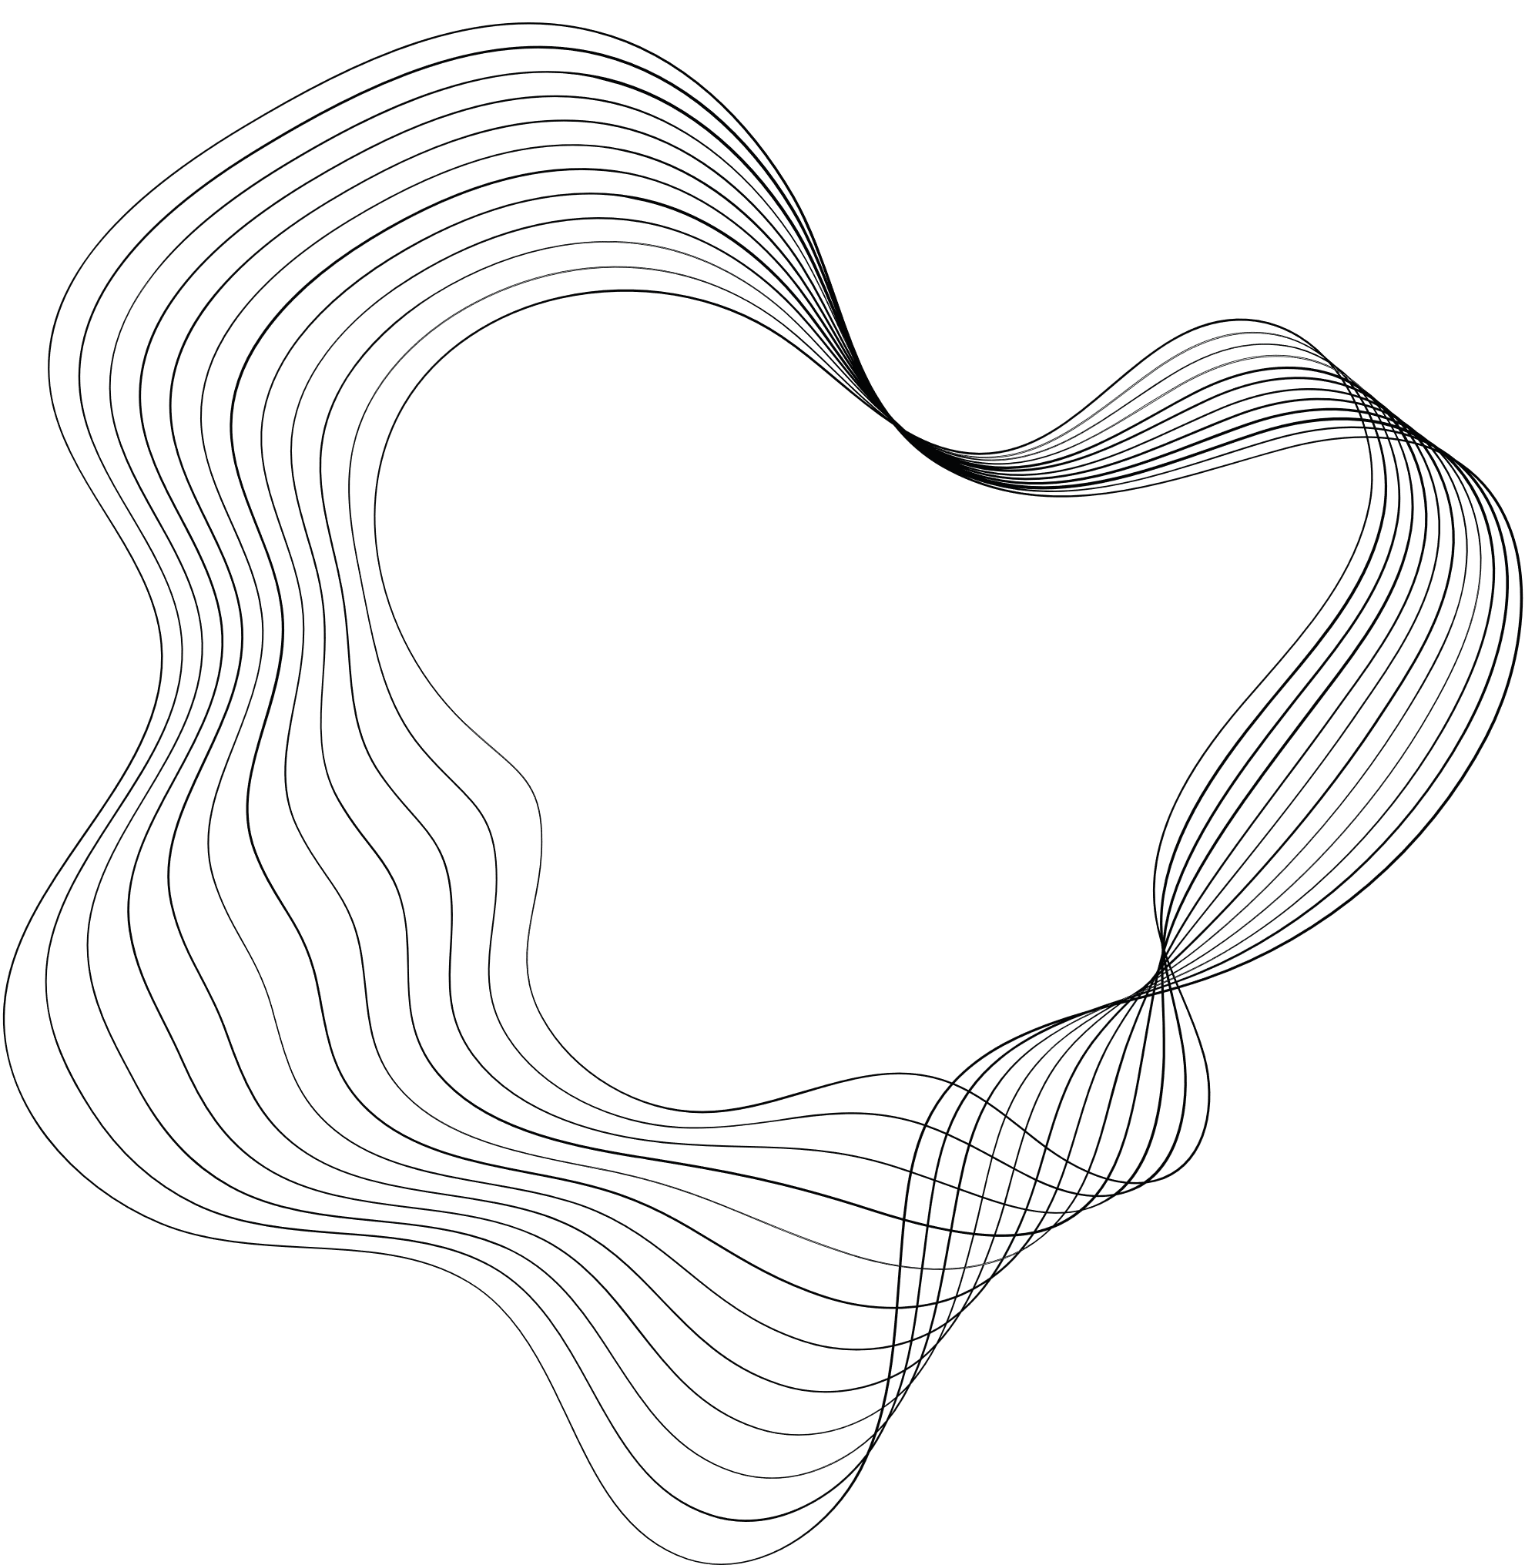
02
CONTENT
01
INTRODUCTION
02
CONTENT
03
PROBLEM STATEMENT & OBJECTIVE
04
DATA MODELLING
05
WORK FLOW
06 - 11
DATA VISUALIZATION STORIES
12
CHALLENGES
13
CONCLUSION

Slide 3
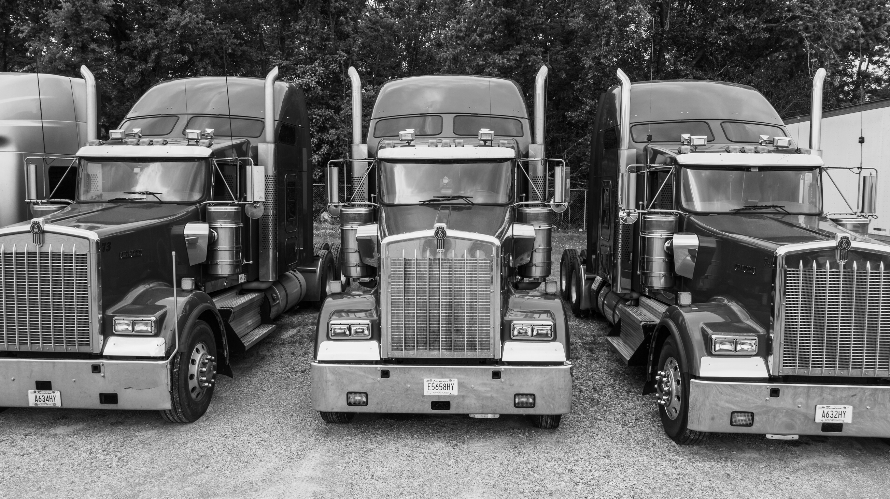
03
PROBLEM STATEMENT
Az National Trucking (ANT) wants to ensure that all of its drivers comply with the rules and regulations governing the trucking industry, with a specific focus on mitigating risk factors that can lead to accidents. The organization is concerned about various aspects of driver behavior and operational parameters, including mileage and speed, as well as other compliance guidelines outlined by FMCSA regulations, the Department of Transportation, and state-specific laws.
BUSINESS OBJECTIVE
  Determine dangerous commercial truck drivers nationwide
  Highlight the drivers who have a “mileage/risk factor” greater than or equal to 7.0
  Identify drivers with high-risk factors, thus we can implement appropriate measures to improve safety and reduce accidents caused by large trucks.

Slide 4
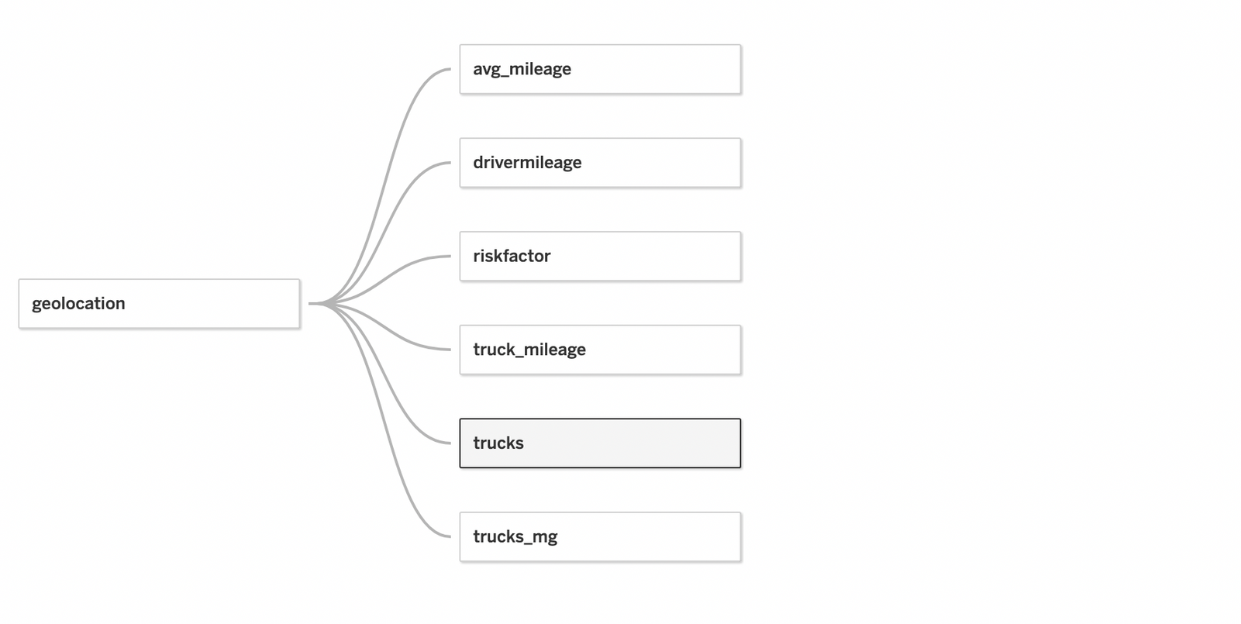
04
DATA MODELLING
Using geolocation, trucks, and trucks_mg datasets for the analysis

Slide 5
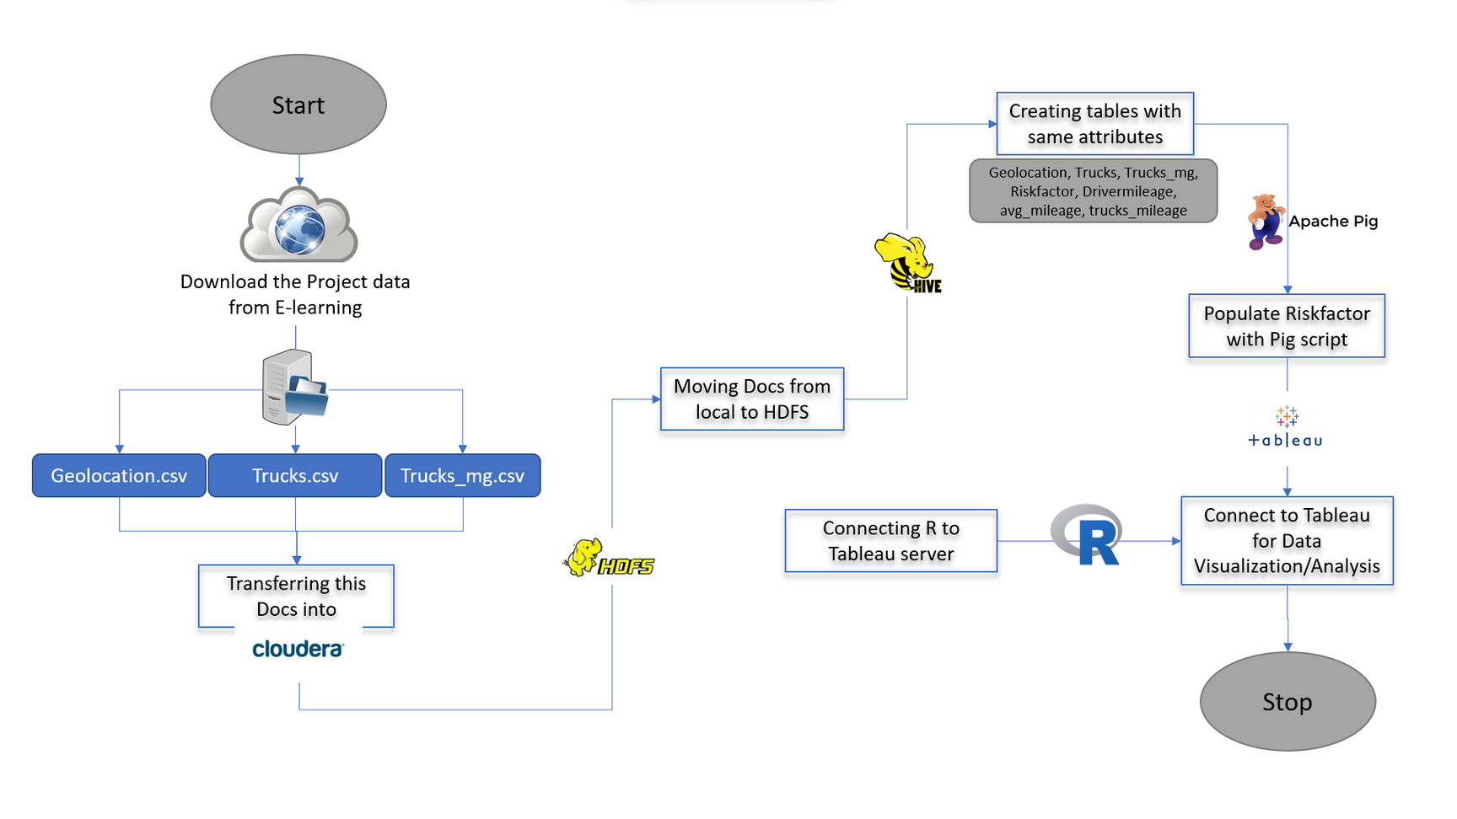
05
WORKFLOW
05

Slide 6
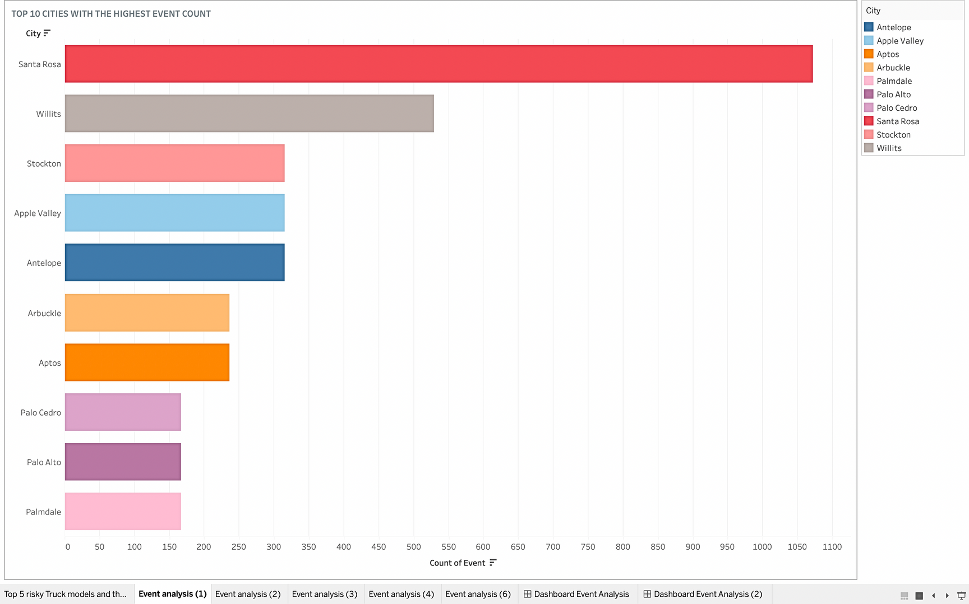
STORY 1
Top 10 cities with the highest event count:
  Santa Rosa
  Willits
  Stockton
  Apple Valley
  Antelope
  Arbuckle
  Aptos
  Palo Cedro
  Palo Alto
  Palmdale
06

Slide 7
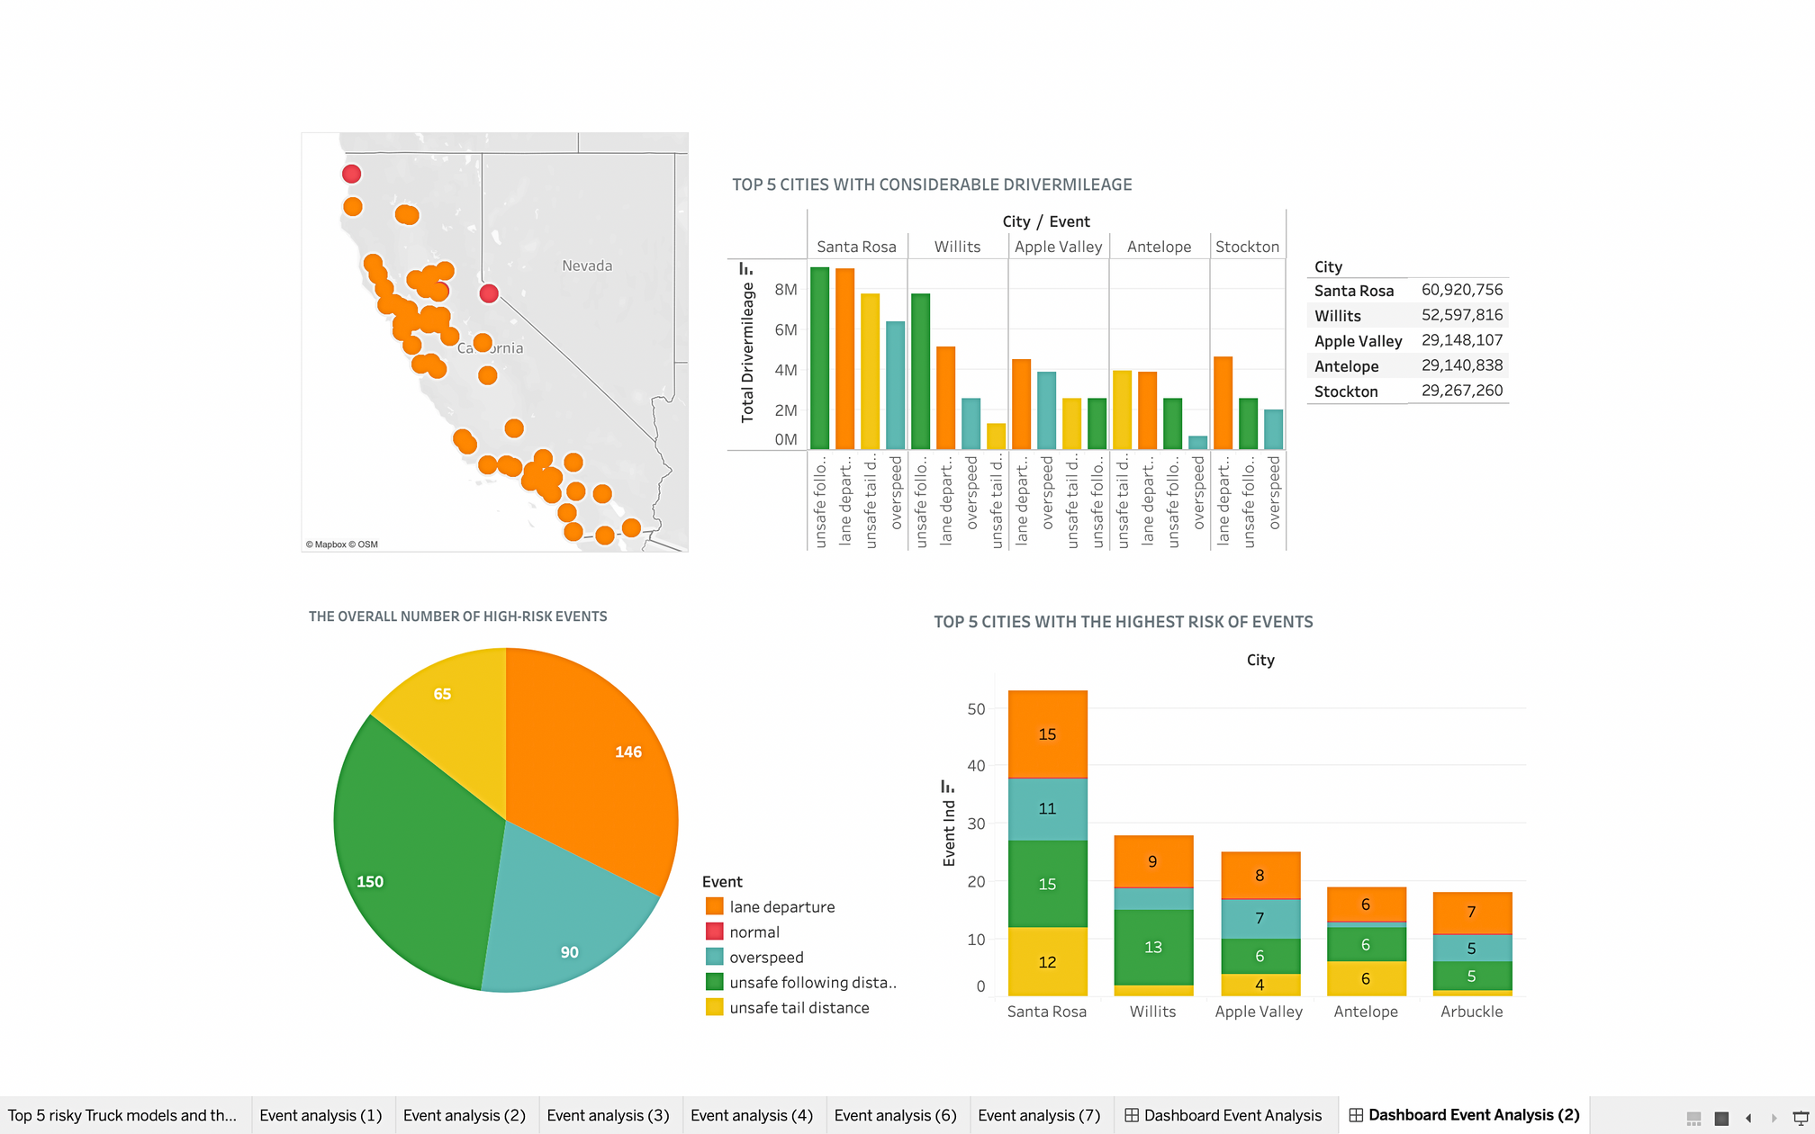
STORY 1a
  Highest risk events are unsafe following distance & lane departure
2. According to the analysis chart, Santa Rosa emerges as the city with the most risky events and the highest driver mileage.
=> High-risk drivers
=> Increasing risk because of a significant influx of truck traffic passing through the city.
07

Slide 8
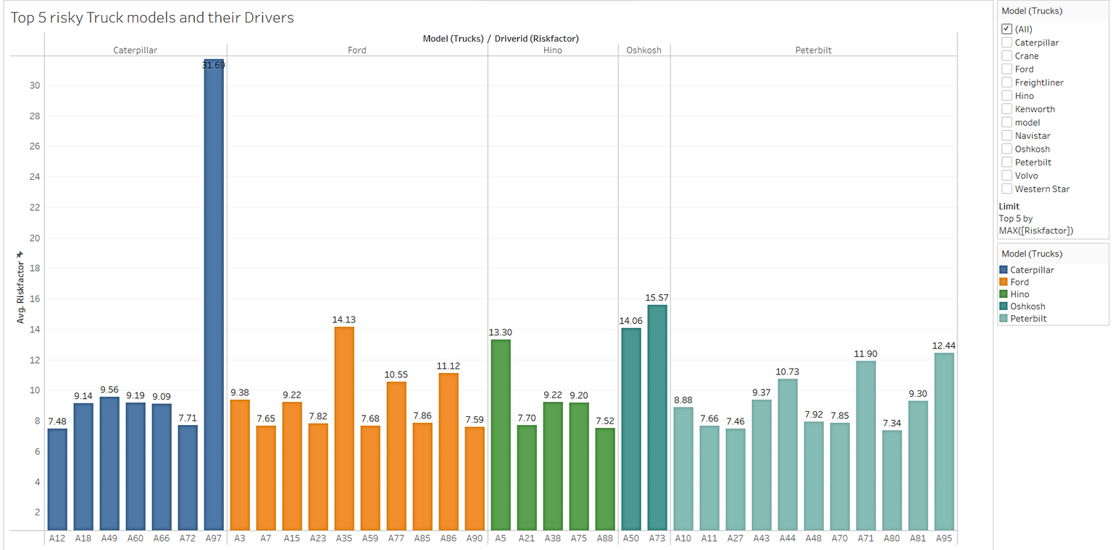
STORY 2
  From the Bar graph, Peterbilt have 11 riskiest drivers out of 16 with risk factor above 7 which ideally makes PETERBILT riskiest truck model.
  Considering the cumulative average, CATERPILLAR is the riskiest truck model as the all the drivers risk factor is above 7.
08

Slide 9
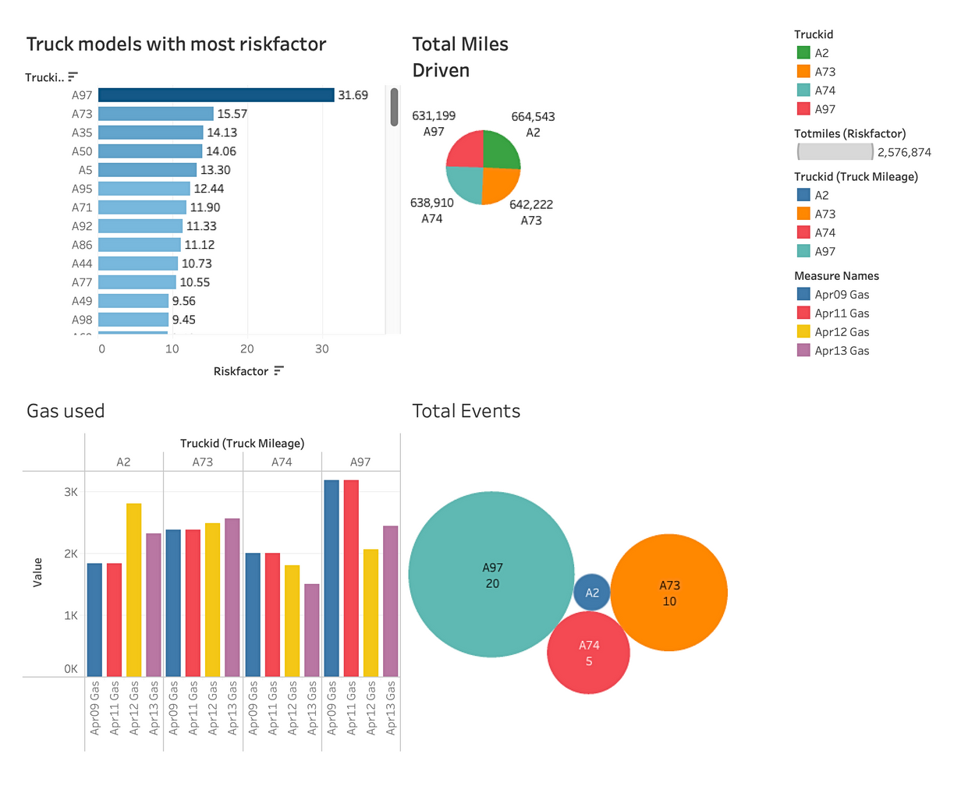
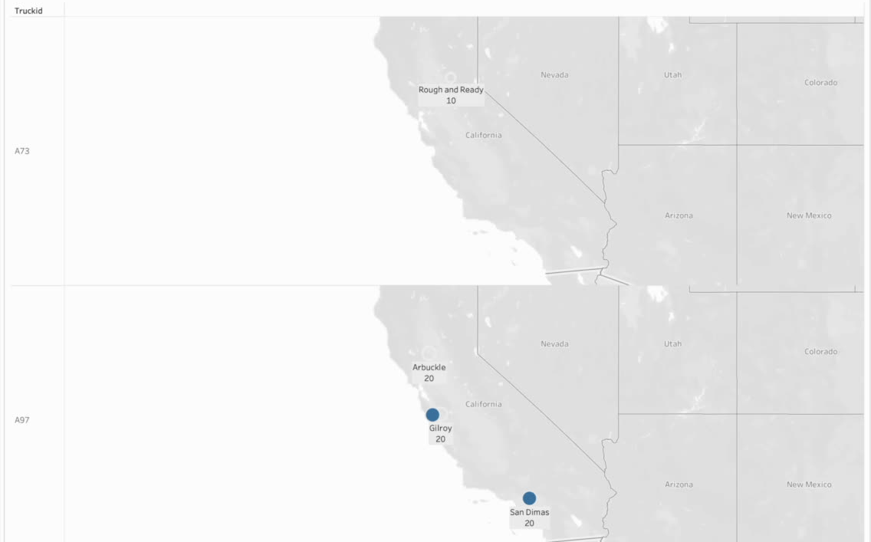
STORY 3
  Analyzing Trucks with High and Low Risk Factors, Including Metrics such as Miles Driven, Events, and Fuel Consumption.
09

Slide 10
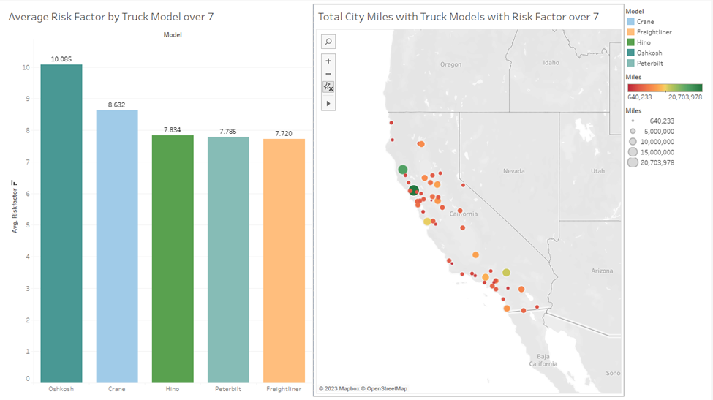
STORY 4
  The truck models with an average risk factor of over 7 drove the most miles in the city of Santa Rosa. And the least amount of miles was Knightsen.
10

Slide 11
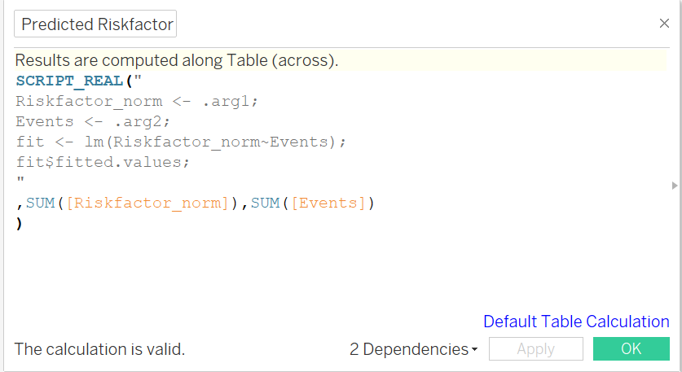
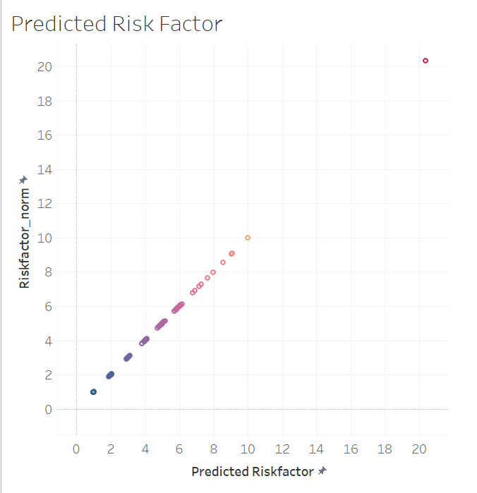
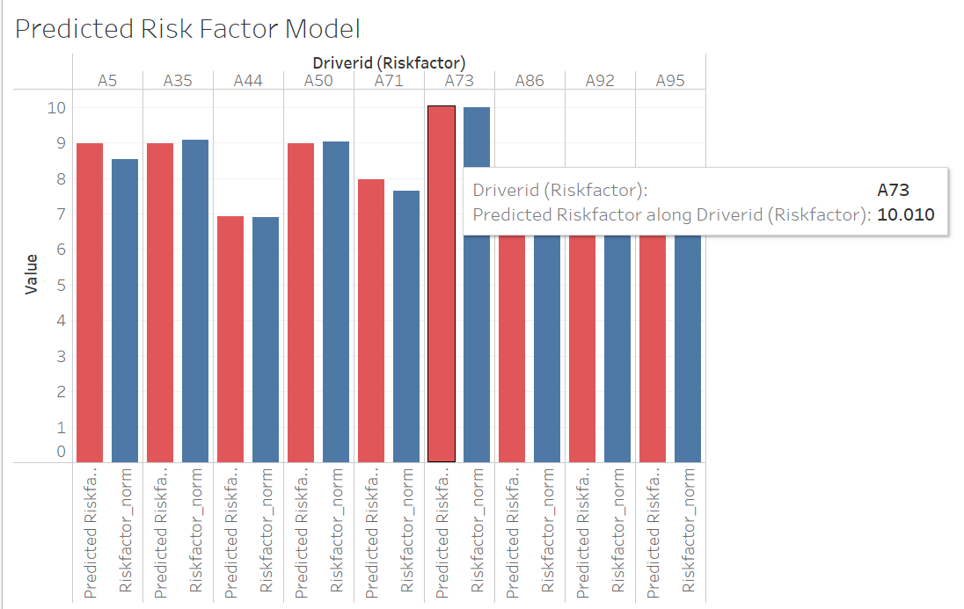
R integration in Tableau
11

Slide 12



12
challenges
Accessing Tableau
New Experience
Connectivity
  We are required to provide the new IP address of VMware to establish a connection to the Impala database.
  Several team members were unfamiliar with Tableau, requiring them to learn the process of creating stories and dashboards, which presented a challenging but valuable learning experience.
  Encountered Intermittent network connectivity issue with Cloudera Hadoop and Tableau.

Slide 13



13
CONCLUSION
1
2
3
4
Further research should be done by the concerned authorities to find the reason for the abnormality of the outlier A97
Based on the analysis, after removing the outlier, A73 is the riskiest driver with a risk factor above 7 & a high possibility of causing accidents.
In future, In order to decide whether total miles or velocity which is more preeminent can be analyzed by performing Regression Analysis.
Additionally, acquiring further information about drivers is essential for a more comprehensive analysis of the risk factor.

Slide 14

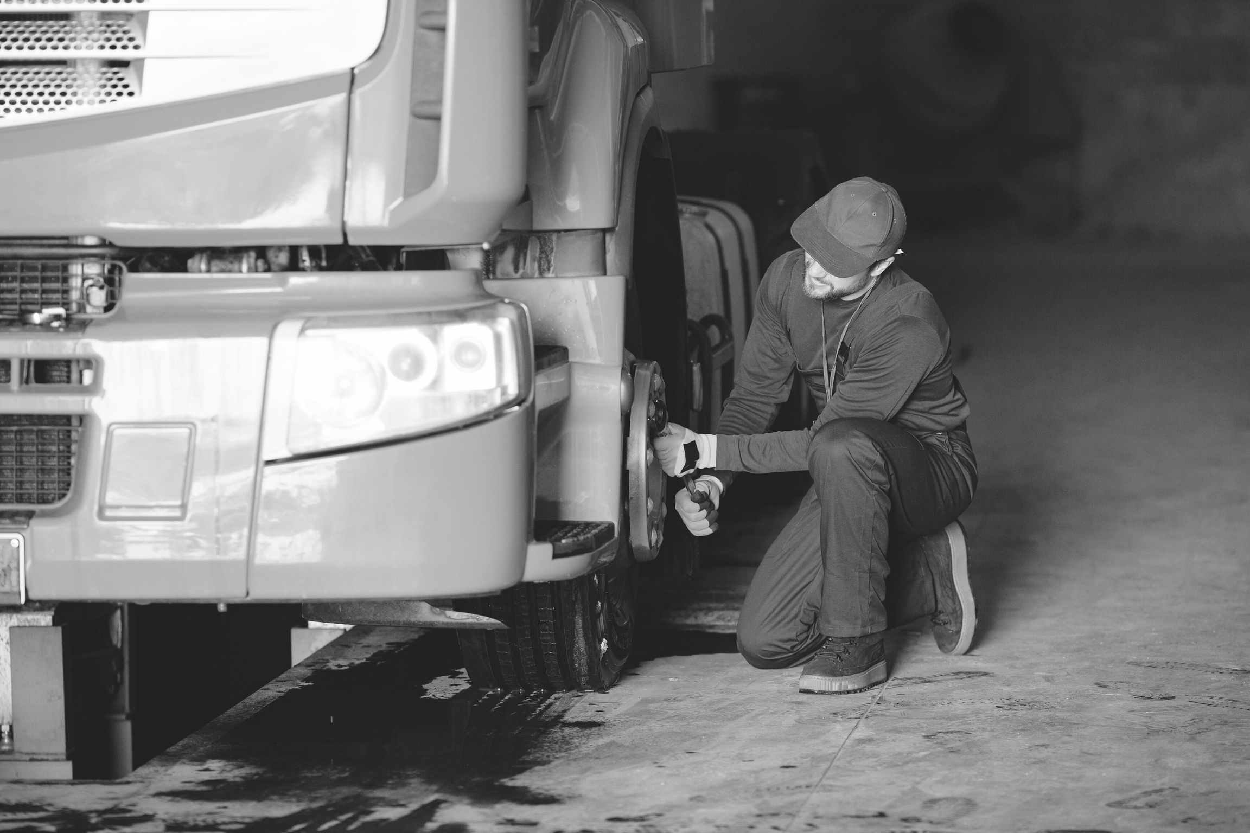
14
Thanks for listening!
[Open to question]

