Slide 1
Excel Project
Pranav Panchal

Slide 2
AGENDA
Models
Problem statement
Learning outcomes
Summary.

Slide 3
Models
Discrete Optimization.
Simulation in Crystal ball
Dynamic Binary tree

Slide 4
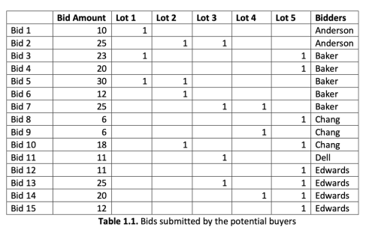
Discrete optimization
Problem Statement
The Richardson Development Company (RDC) has just acquired a large plot of land in Plano. RDC has divided this land into five smaller lots, which it would now like to sell to individual buyers interested in developing them.
RCD has just received a large number of bids from several potential buyers. These bids are shown in Table 1.1. Six families participated in the auction (Anderson, Baker, Chang, Dell, and Edwards) and submitted 15 distinct bids. As shown in Table 1.1., each bid specifies the name of the bidder, the lot(s) to buy, and the total amount to pay if the bid is accepted. Note that some bidders submitted multiple bids; for example, Edwards submitted four bids (12, 13, 14, and 15). Also, note that a bid may be for multiple lots; for example, the Anderson family wants to build a large house, so their bid 2 is for lots 2 and 3. A lot cannot be split into smaller pieces due to the town’s parceling laws for residential land.

Slide 5
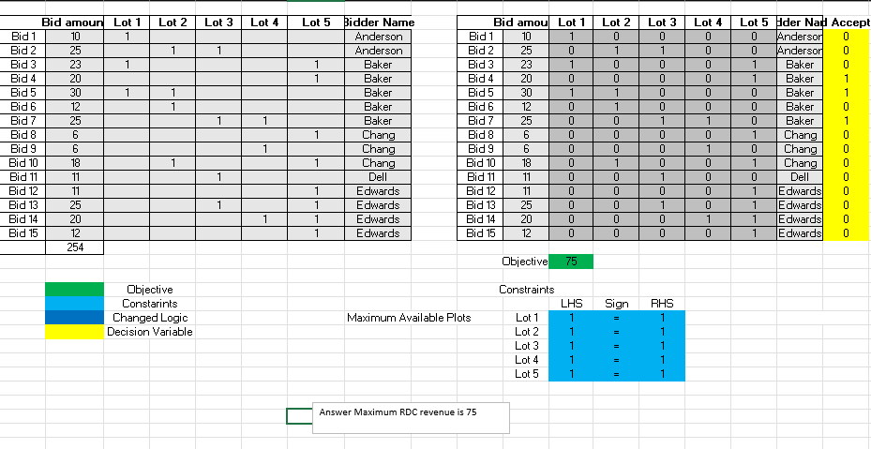
RDC would lie to generate the maximum possible revenues from the bids received. You are asked to develop a quantitative model that helps guide their decisions.
Please address each of the following questions separately unless explicitly directed otherwise. Clearly identify the decisions, the objective, and the constraints in your model by (a) highlighting/coloring cells, and (b) typing explicit comments in your spreadsheet. Your models should remain linear. If you feel that some modeling element is ambiguous and you need to make additional assumptions, please state them explicitly in your spreadsheet and proceed.
Construct a discrete optimization model (i.e., with binary variables) that determines which bids should be accepted in order to maximize RDC’s revenues from the auction. What is the optimal revenue that can be achieved, and which bids should be accepted?
Answer: The optimal revenue that can be achieved is 75.

Slide 6
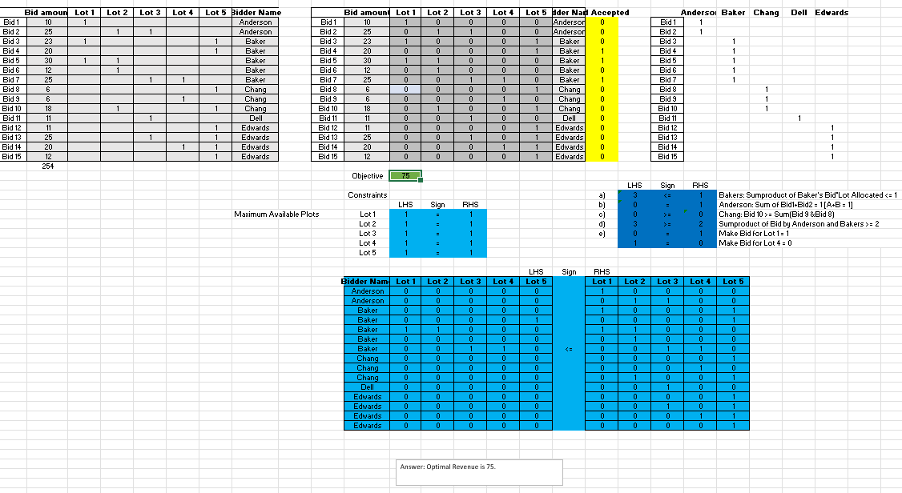
2. RDC would like to include some additional restrictions in the allocation to capture some crude fairness considerations. In addition, it also decided to allow bidders to include “terms” in their bid, specifying particular restrictions that its allocation must meet. For each of the following considerations, state which constraint (s) you would add in your model from part 1 to properly capture this feature. It is sufficient to write formulas that adequately reflect your changes, and there is no need to resolve your model here!
The Bakers added a term that they should not win multiple bids.
The Andersons added a term stating: “If we win Bid 1, then we drop Bid 2”. In other words, if they win Bid 1, then Bid 2 should not be considered.
The Changes added a term stating: “If we win Bid 10, we drop all our other bids.”
RDC would like to ensure that if at least one of the Andersons’ bids is accepted, then at least one of the Bakers’ buds should also be accepted.
The Bakers added a term stating: “If we get lot 1, then we drop any bids involving lot 4.”
Answer: The answer is the same i.e 75, after making some changes in the constraints

Slide 7
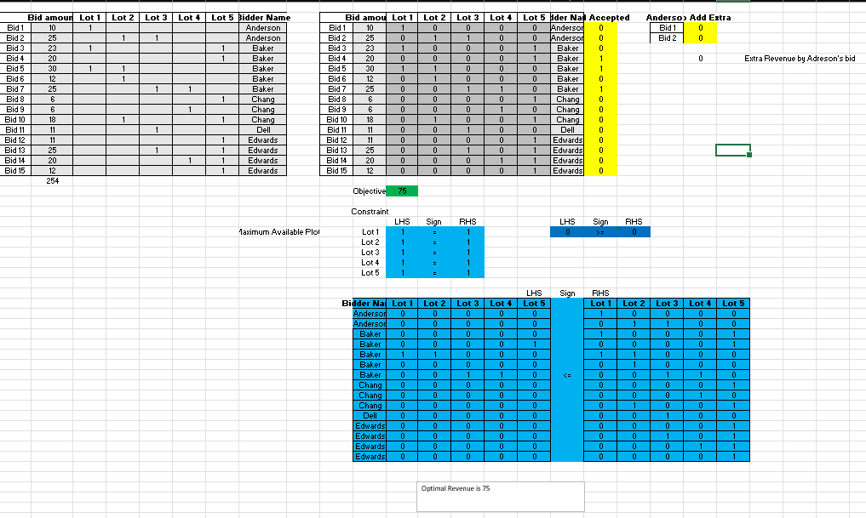
3. The Anderson family has just submitted a very interesting addendum to their original bids in Table 1. If any of their bids are accepted, they are willing to waive all contingencies and inspections. RDC estimates this would amount to an extra revenue of about 9 units. (For instance, if RDC were to accept both Anderson bids, they would get a total revenue of 10 + 25 + 9). Update the model you constructed in part 1 to accommodate this feature. What is the optimal revenue that can be achieved, and which bids should be accepted?
Answer: The optimal revenue is 75 so there is no extra revenue generated from the additional Anderson’s bid

Slide 8
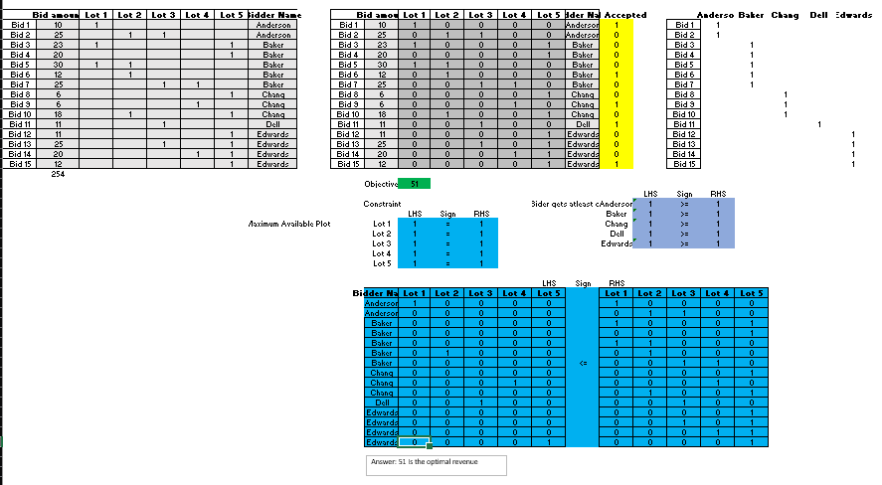
4. RDC believes there may be many long-term advantages in having each of the five bidders receive a plot of land. Change the model you constructed in part 1 to accommodate this feature. What is the optimal revenue that can be achieved, and which bids should be accepted?
Answer: So now the optimal solution is 51.

Slide 9
Simulation
Problem Statement
Simulation Lobstah Claw operates a fleet of five lobster boats in Boston, Massachusetts. Every weekday of the year, each boat leaves early in the morning, hauls in lobster traps for most of the day, and completes its catch of lobster by mid-afternoon. The operating cost for one day is $450 per boat.
Once all five boats have returned with their daily catch, Lobstah Claw can sell lobster to Louie’s Lobster Shack (a local restaurant) and Star Market (a local grocery store chain). Lobstah Claw gets to decide every day how many pounds of lobster to sell to each buyer so as to never have any leftover lobster at the end of the day. The price that Louie’s Lobster Shack is willing to pay is very uncertain and can change quite a bit, even on a daily basis. Using historical data, Lobstah Claw estimates that this is triangularly distributed, with a minimum value of $1.50, maximum value of $5.50, and likeliest value of $3.50.
On the other hand, the price Star Market is willing to pay is a function of the total amount of lobster that Lobstah Claw is trying to sell to them in one day. More precisely: Star Market Price = $3.85 - $0.0005 * ( Amount of Lobster Sold to Star Market, in pounds ) For instance, if Lobstah Claw is trying to sell 100 pounds of lobster to Star Market, the store would pay $3.80 per pound.
Unfortunately, the amount of lobster caught by each boat is also uncertain. Lobstah Claw has estimated that the daily catch for each boat is normally distributed, with a mean of 300 pounds, and a standard deviation of 50 pounds.
For the following questions, if you feel that some modeling element is ambiguous and you need to make additional assumptions, please state them explicitly in your spreadsheet and proceed.

Slide 10
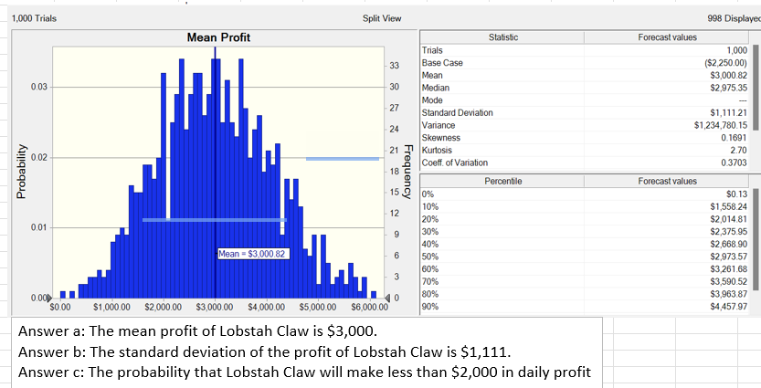
Build a simulation model to predict the mean daily profit of Lobstah Claw when they sell 60% of the lobster caught to Louie’s Lobster Shack (and the remaining lobster to Star Market).
What is the mean profit of Lobstah Claw?
What is the standard deviation of the profit of Lobstah Claw?
What is the probability that Lobstah Claw will make less than $2,000 in daily profit?

Slide 11
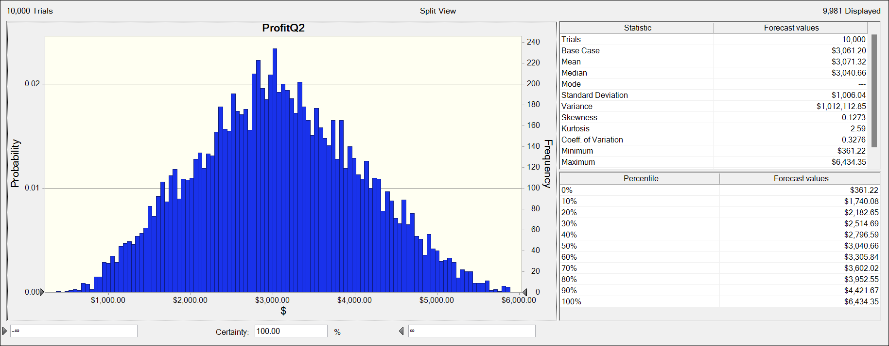
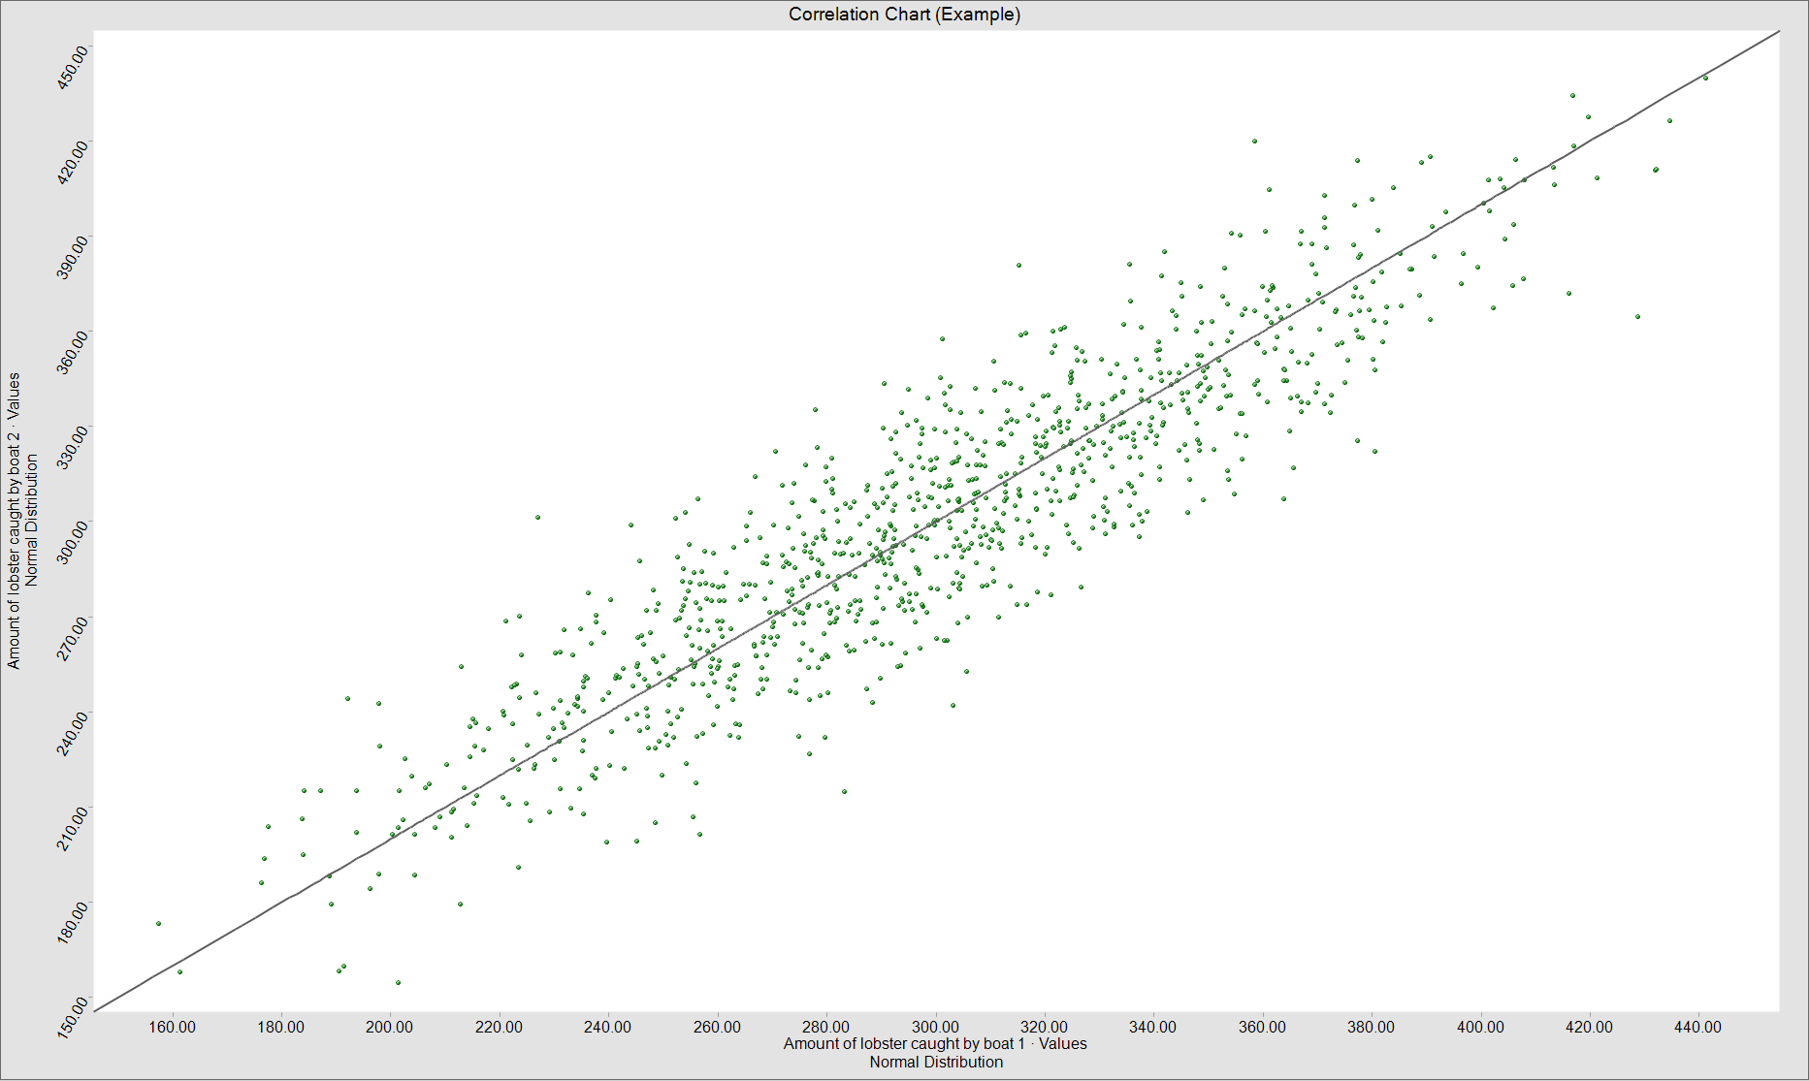
2. What percentage of the lobster caught should Lobstah Claw sell to Louie’s Lobster Shack to maximize the expected profit?
3. Consider now the following change to the model you constructed in part 1: the amount of lobster caught by Boat 1 and the amount of lobster caught by Boat 2 are positively correlated, with a correlation coefficient of 0.9 (these two boats follow very similar routes). How does the mean and standard deviation of profit compare to your answers in part 1? Why should you expect to see this change?

Slide 12
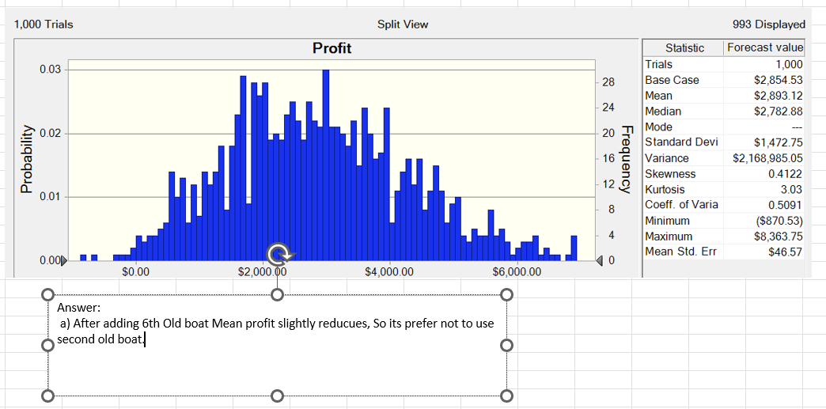
4. Suppose that Lobstah Claw has the option of using an older sixth boat in addition to the five boats described above. Since the boat is so much older, it has twice the operating cost of the other boats ($900), and the amount of lobster it can bring in is more uncertain. Lobstah Claw estimates that the amount of lobster the sixth boat brings in is uniformly distributed from 100 pounds to 500 pounds.
Adjust your model in part 1 to account for the possibility of using the sixth boat. Assuming that Lobstah Claw sells 60% of their total lobster to Louie’s Lobster Shack, should Lobstah Claw use the additional boat?

Slide 13
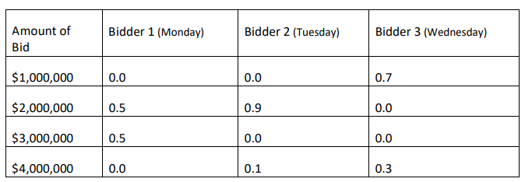
Dynamic Binary Tree
Problem Statement
The Newtone Art Gallery has a valuable painting that it wishes to sell at auction. There will be three bidders for the painting. The first bidder will bid on Monday, the second on Tuesday, and the third will bid on Wednesday. Each bid must be accepted or rejected that same day. If all three bids are rejected, the painting will be sold for a standing offer of $900,000. Newtone’s chief auctioneer’s estimates for the bid probabilities are contained in the next table.
For example, the auctioneer has estimated that the likelihood the second bidder will bid $2,000,000 is 90%. Formulate and solve the problem of deciding which bid to accept as a decision tree. What should the auctioneer do?

Slide 14
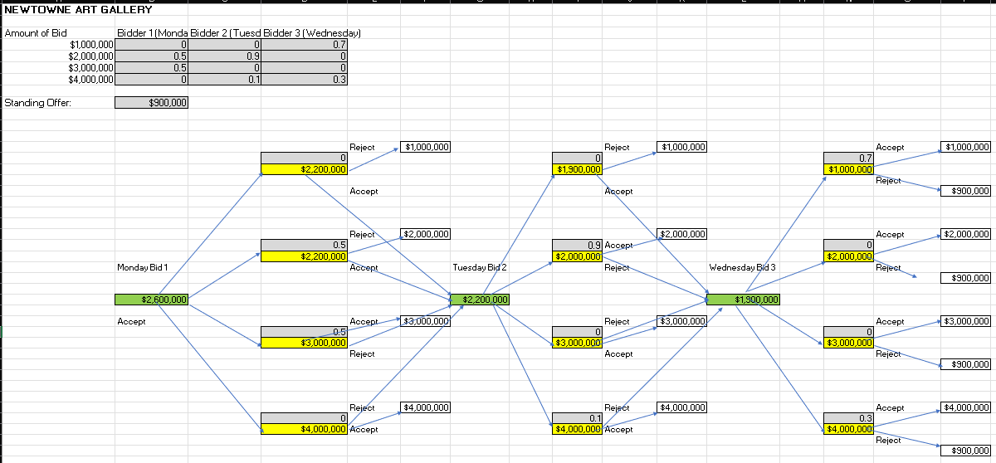
Binary Tree
The final Bid accepted is $2.6M.

Slide 15
Learning Outcome from all 3 models
Discrete Optimization
Simulation
Dynamic Binary Tree
Understand the process of formulating a discrete optimization model for revenue maximization.
Demonstrate proficiency in constructing linear optimization models in Excel.
Ability to incorporate additional constraints to capture fairness considerations in allocation decisions.
Develop a simulation model to predict outcomes under uncertain conditions.
2. Utilize simulation results to make strategic decisions, such as determining optimal sales percentages.
3. Evaluate the feasibility of incorporating additional resources or options into decision-making processes based on simulation outcomes.
Formulate decision trees to model sequential decision-making processes.
Evaluate probabilities associated with different decision paths to determine optimal strategies.
Recommend optimal actions based on decision tree analysis to maximize outcomes in auction settings.

Slide 16
SUMMARY
The presentation showcases the application of Excel models in solving diverse business problems encountered in operations research and management.
Discrete Optimization: The first problem focuses on revenue maximization for the Richardson Development Company through the acceptance of bids for subdivided land. Construct a linear optimization model and incorporate additional constraints to ensure fairness in bid allocation, demonstrating proficiency in quantitative modelling and strategic decision-making.
Simulation: The second problem involves predicting daily profits for Lobstah Claw's lobster fleet operations under uncertain conditions. Through simulation modelling, analyzed mean profits, standard deviations, and probabilities to optimise sales strategies and assess the impact of correlations and additional resources on profitability.
Dynamics using Decision Trees: The final problem centres on Newtone Art Gallery's auction strategy for a valuable painting, employing decision tree analysis to maximize auction revenue. formulated decision trees to evaluate bid probabilities and recommend optimal actions at each stage of the auction, showcasing their ability to navigate complex decision-making scenarios.

Slide 17
THANK YOU
Click to open Excel File

